Slide 1
Recupero ponderale dopo interventi malassorbitivi
Francesco Saverio Papadia, MD, FACS, FEBS (SurgOnc)
Dipartimento di Scienze Chirurgiche e Diagnostiche Integrate DISC
Università degli Studi di Genova

Slide 2
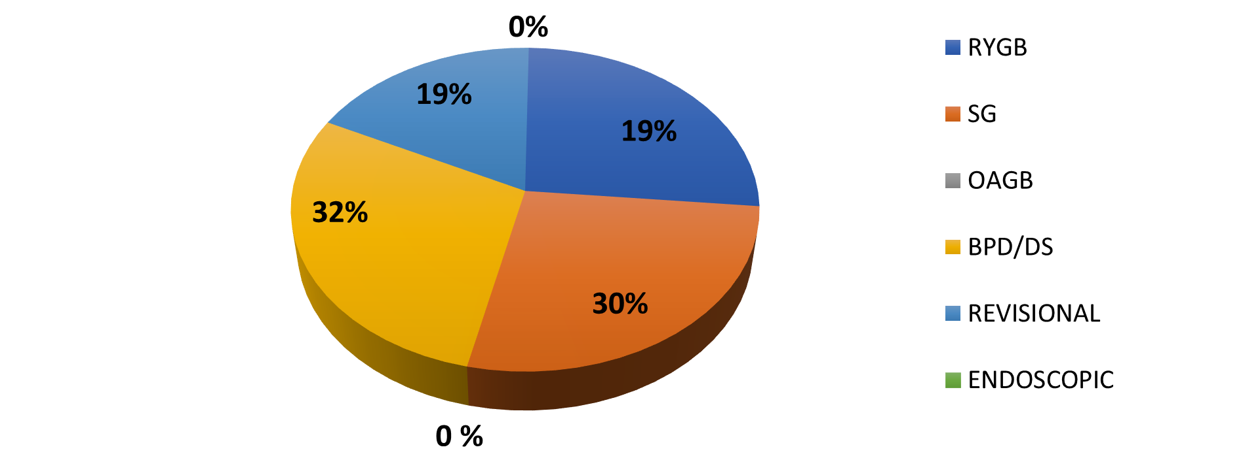
Nessun conflitto di interesse da dichiarare

Slide 5
Esiste weight regain dopo chirurgia malassorbitiva?
Quanti pazienti recuperano peso?

Slide 6
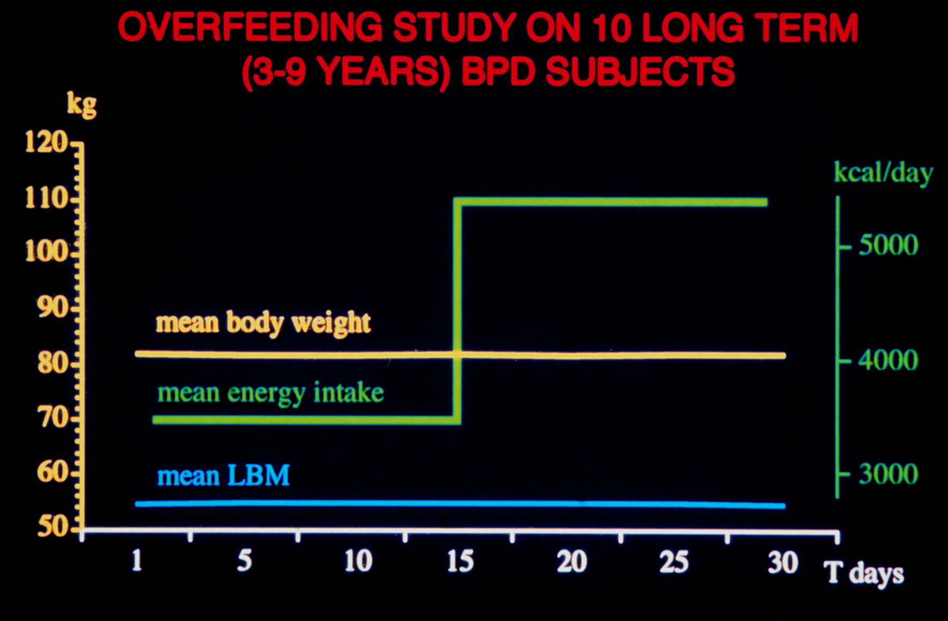

Slide 7
DAILY ENERGY INTAKE HIGHER THAN DAILY ENERGY ABSORPTION CAPACITY
energy intestinal absorption threshold
ENERGY
ABSORPTION
CAPACITY

Slide 8
DAILY ENERGY INTAKE HIGHER THAN DAILY ENERGY ABSORPTION CAPACITY
energy intestinal absorption threshold
ENERGY
ABSORPTION
CAPACITY
ENERGY
INTAKE

Slide 9
DAILY ENERGY INTAKE HIGHER THAN DAILY ENERGY ABSORPTION CAPACITY
energy intestinal absorption threshold
ENERGY
ABSORPTION
CAPACITY
ENERGY
INTAKE
ENERGY
ABSORPTION

Slide 10
DAILY ENERGY INTAKE HIGHER THAN DAILY ENERGY ABSORPTION CAPACITY
energy intestinal absorption threshold
ENERGY
ABSORPTION
CAPACITY

Slide 11
DAILY ENERGY INTAKE HIGHER THAN DAILY ENERGY ABSORPTION CAPACITY
ENERGY
INTAKE
energy intestinal absorption threshold
ENERGY
ABSORPTION
CAPACITY

Slide 12
DAILY ENERGY INTAKE HIGHER THAN DAILY ENERGY ABSORPTION CAPACITY
ENERGY
INTAKE
ENERGY
MALABSORPTION
energy intestinal absorption threshold
ENERGY
ABSORPTION
CAPACITY
ENERGY
ABSORPTION

Slide 14
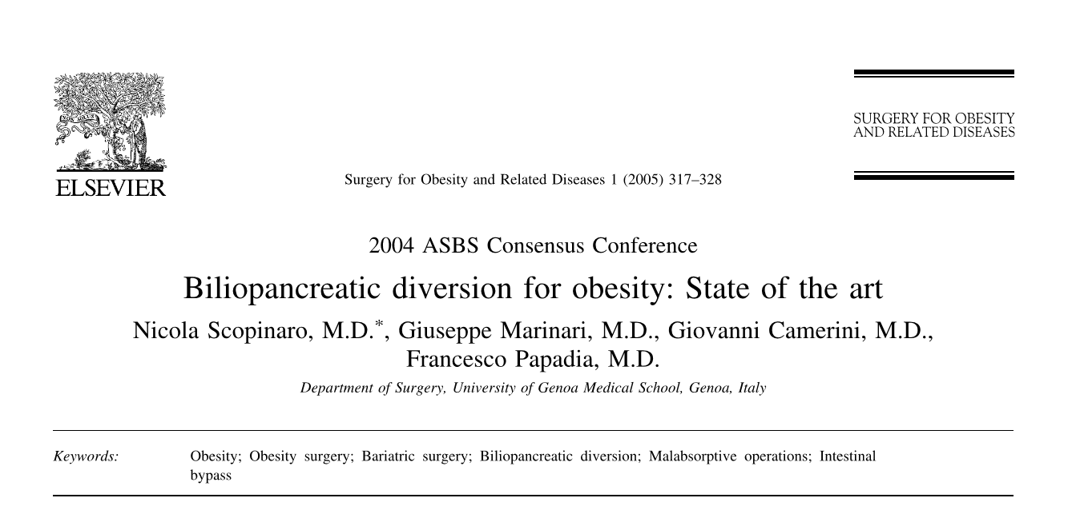
At 10 years, 90% of the operated patients had a reduction of the initial excess 50%, with a rate of failure (ie, loss of 25% of excess) of 0.5%

Slide 15
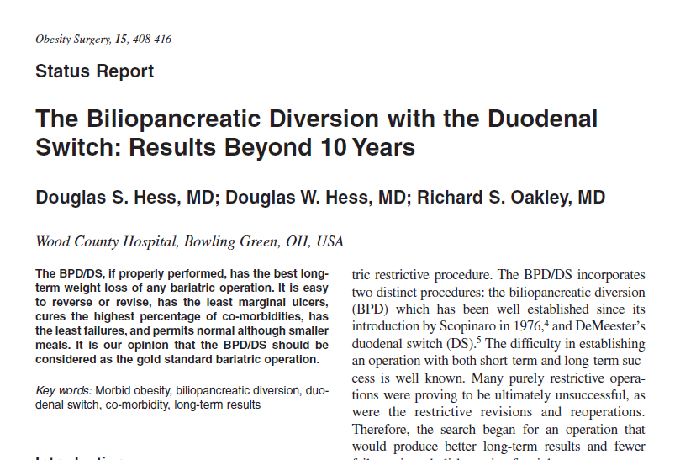
The average excess weight loss (EWL) at 10 years is 75%. In these 167 patients, 94% are in the satisfactory category (i.e. ≥50% excess weight loss

Slide 16
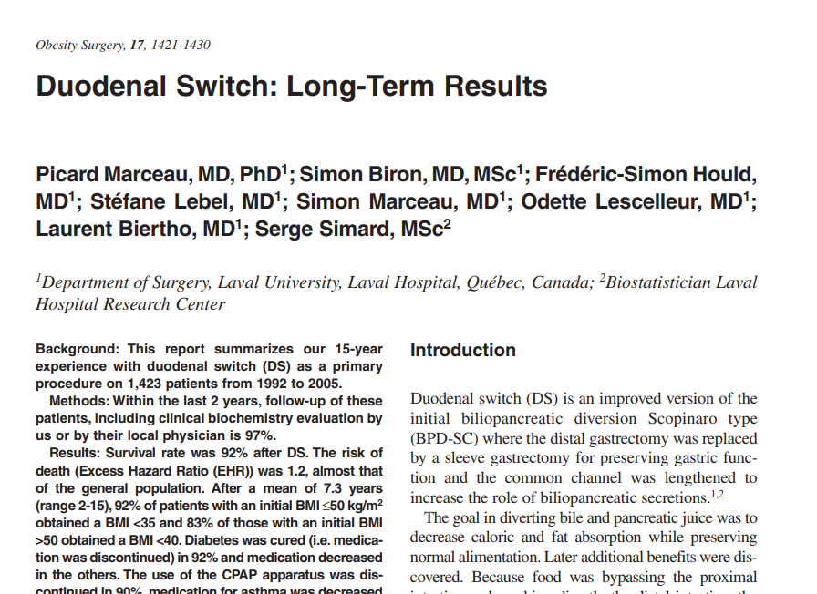
Repeat surgery for insufficient weight loss or weight regain was necessary in 20 patients (1.5%)

Slide 17
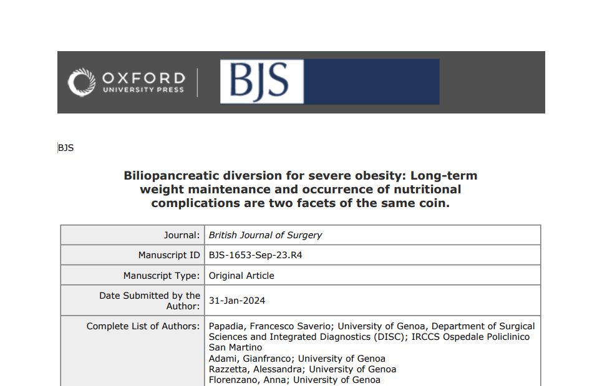

Slide 18
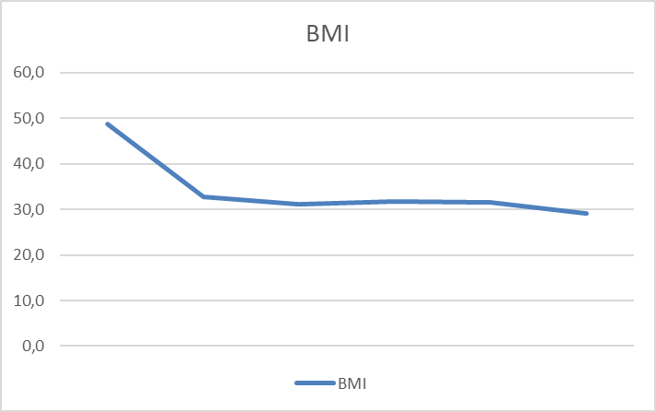
Long-term weight loss and weight maintenance after AHS-AHAL BPD
Preop 1 year 5 years 10 years 20 years 30 years

Slide 19
Long-term weight loss and weight maintenance after AHS-AHAL BPD
Follow-up: | Preoperatively | 1 year | 5 years | 10 years | 20 years | 30 years
BMI (kg/m²) | 41.8 (32.0-74.0) | 32.8 (20.1-52.6) | 31.2 (22.1-51.4) | 31.8 (18.5-54.6) | 31.9 (20.4- 57.8) | 30.8 (16.2-42.7)
% Excess BMI loss | 0 | 67.1 | 73.8 | 71.5 | 72.3 | 75.6
Percent of total weight loss (%TWL) | 0 | 32.8 | 36.1 | 35.0 | 34.3 | 37.7
ΔBMI | 0 | 15.9 | 17.5 | 17.0 | 17.2 | 18.0
Nr. of patients | 199 | 192 | 184 | 155 | 122 | 38
31.8 (18.5-54.6)

Slide 20
TWL% dopo BPD
TWL% | negativo | < 15% | < 20% | 20-30% | 30-40% | 40-50% | >50%
1 anno (186 p) | 0 | 0.5% (1) | 5% (11) | 34% (63) | 46% (85) | 14% 826) | 0.5% (1)
5 anni (181 p) | 0 | 0.6 (1) | 3.5% (6) | 24% (41) | 46% (79) | 46 (27%) | 3% (5)
10 anni (108 p) | 1% (1) | 3.7% (4) | 6.4% (7) | 27% (29) | 34% (37) | 18.5% (20) | 6.5% (7)
20 anni (106 p) | 1.9% (2; 13%) | 7.5% (8) | 4.7% (5) | 30% (32) | 24% (25) | 22% (23) | 7.5% (8)
30 anni | 0 | 5% | 10% | 5% | 20% | 17% | 33% (22 %> 60)

Slide 26
Cause di recupero di peso dopo chirurgia ipoassorbitiva:
dieta eccessivamente ricca in zuccheri semplici, o alcool (cave: la soglia di malassobimento è un modello)
grazing, nibbling (Prader-Willi-Syndrome)
variazione della composizione corporea con riduzione del REE (invecchiamento, menopausa, iatrogeno)
Errore nelle misurazioni intestinali o nella resezione gastrica (pouch di dimensioni eccessive) con creazione di soglia di malassorbimento inadeguata
eccessivo adattamento intestinale con recupero della capacità di assorbimento di calorie (cave! È possibile recupero di peso e deficit nutrizionale!)

Slide 27
Opzioni revisionali per perdita di peso insufficiente o recupero ponderale
Aggiungere malassorbimento (accorciamento tratto comune/ allungamento tratto biliopancreatico)
Aggiungere restrizione (re-sleeve)

Slide 28
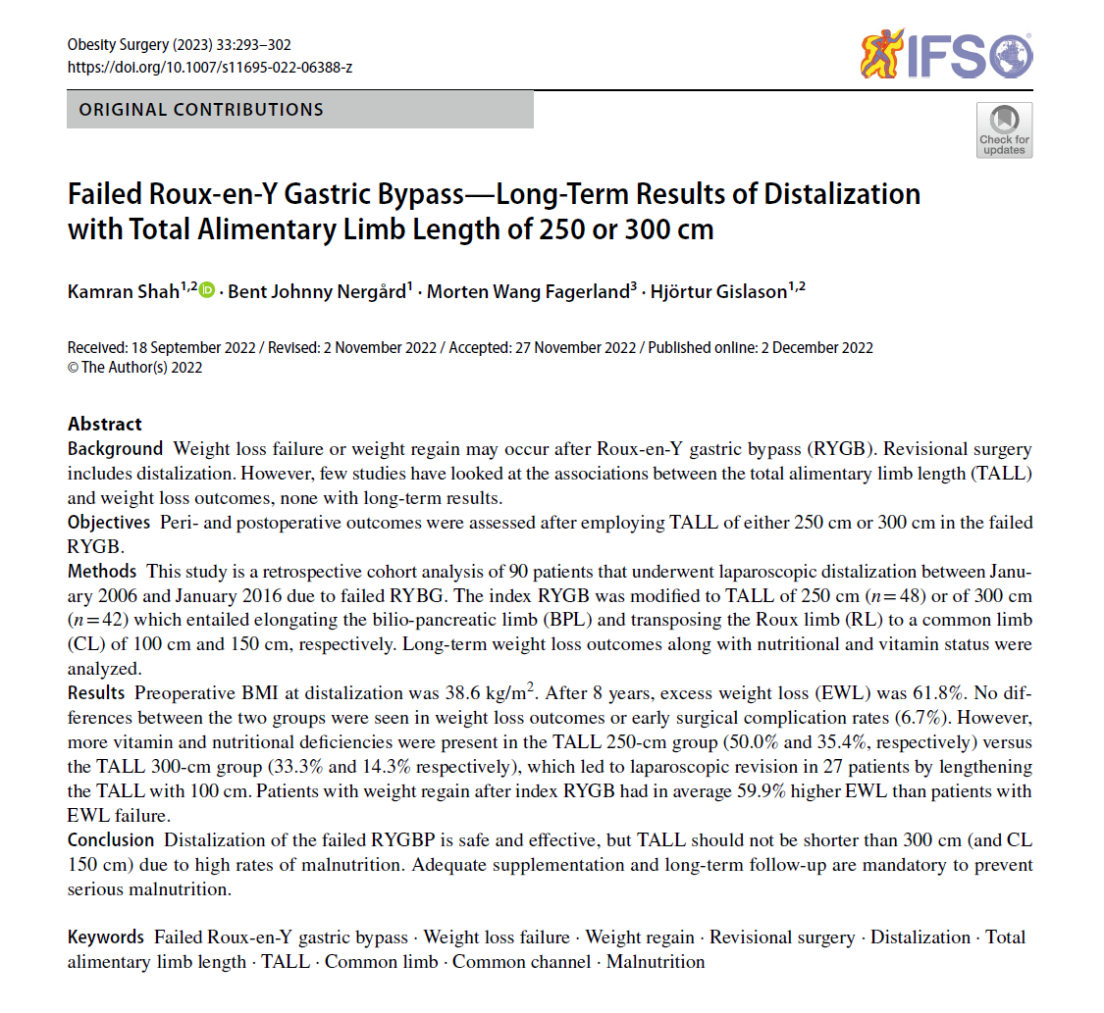

Slide 29
"The initial results were disappointing in terms of weight loss; thus, the TALL in the subsequent patients was shortened further to 250 cm with a common channel of 100 cm...."
"...However, due to an increased prevalence of malnutrition, we decided in the subsequent patients to transpose the AL to 150 cm from the ileocecal valve instead, thereby creating a TALL of 300 cm..."

Slide 30
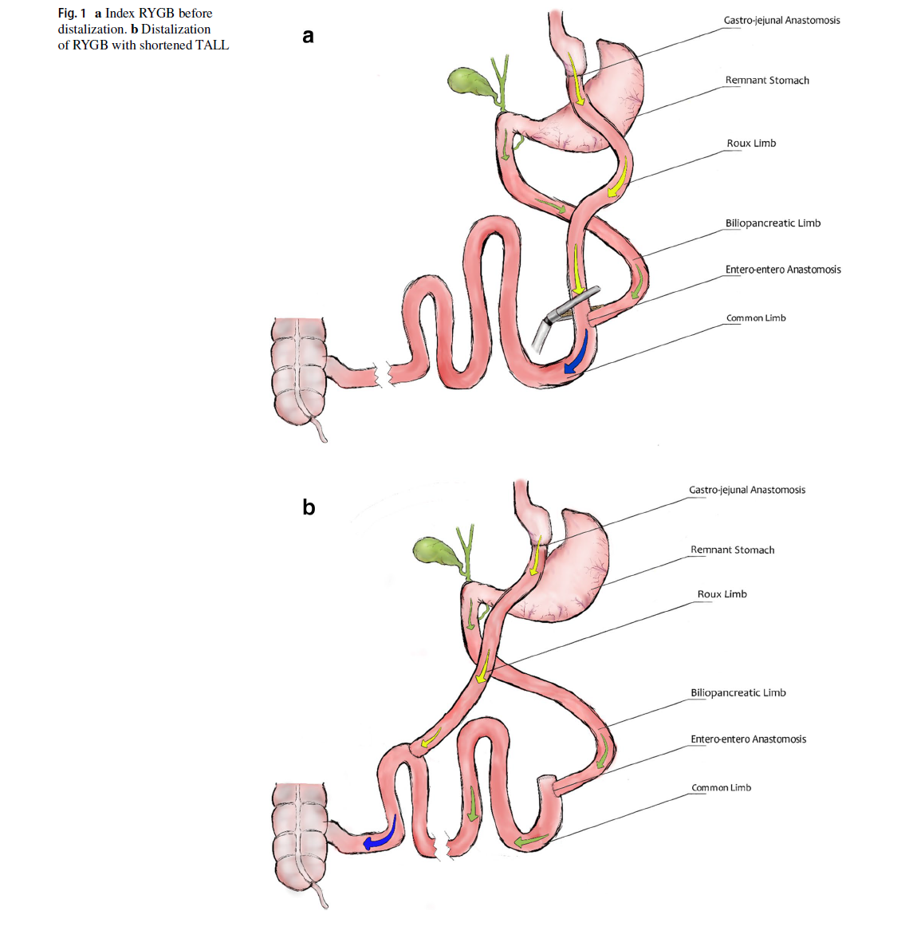

Slide 31
Conferma che esiste una soglia di assorbimento intestinale, e che il malassorbimento è un fenomeno "on-off", e compare solo al di sotto di una specifica lunghezza intestinale, corrispondente alla capacità massima di assorbimento

Slide 32
"However, higher incidence of vitamin deficiencies and malnutrition were noted in the TALL 250-cm group (50.0% and 35.4%., respectively) versus the TALL 300-cm group (33.3% and 14.3% respectively)."

Slide 33
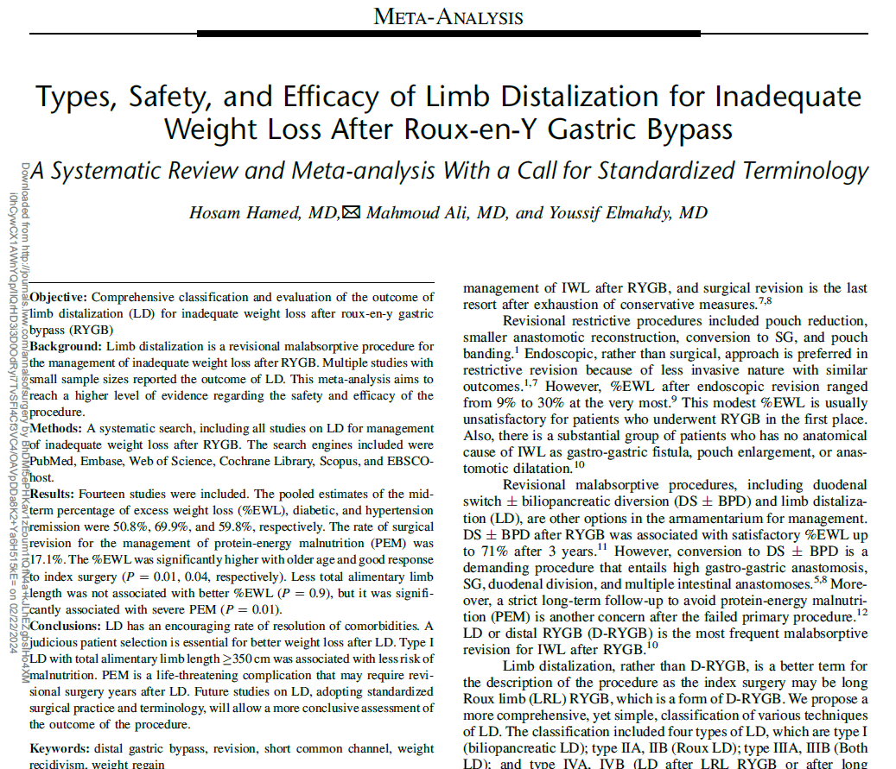

Slide 34
First author Year/Country | Study period | N | Age (years) | Female | DM | HTN | Initial BMI (kg/m²) | Interval (months) | Revisional BMI (kg/m²) | Approach | Technique | TALL (cm) | Op. time (minutes) | H. stay (days)
Kraljević M ^{[4]} (*) 2020/Switzerland | 2008 - 2015 | 28 | 45.3±10.4 | 21 (78%) | 4 (14%) | 7 (25%) | 48.0±6.5 55.4±6.0 | 76.5±38.5 | 41.7±4.5 41.9±4.5 | Both Lap: 64% | I & IV | 250 | 172±58 | 6 (5.7-8.4)
Van der Burgh Y ^{[5]} 2019/Netherland | 2014-2018 | 44 | 44±11 | 33 (75%) | 6 (14%) | 10 (23%) | 49±7 | 76±32 | 43±4 | Lap | IIIB | 375 | 77±28 | 1±1
Shin RD ^{[6]} 2019/USA | 2012-2017 | 22 | 45.9 ±7.1 | 19 (86%) | 4 (18%) | 6 (27%) | 54.1±8.5 | NR | 43.0±5.5 | Lap | I | 256 (200-300) | 132.6±54.4 | 2.2±1.3
Felsenreich DM ^{[1]} 2019/Austria | Till 2016 | 30 | 39.0 (17–61) | 27 (90%) | NR | NR | 47.0±8.2 | 60 (9–144) | 39.1±7.7 | NR | I | 250 | NR | NR
Ghiassi S ^{[15]} 2018/USA | 2010-2016 | 96 | 50.8±9.7 | 82 (85.4%) | 28 (29.2%) | 55 (57.3%) | 48.4±9.0 | 86 | 40.6±7.3 | Lap | I | 275/425 | NR | 1.44±0.6
Thomopoulos T ^{[16]} 2018/Belgium/France | 2013 - 2016 | 15 | 50.3 (32 - 62) | 8 (53.3%) | 7 (46.6%) | 6 (40%) | NR | NR | 41.2 (37-44) | Lap | IIIA | 450 | 165 (150-180) | 3.9 (3-5)
Buckwald H ^{[17]} (**) 2017/USA | 2002-2014 | 53 | 44.6±10.6 41.8±6.3 | 44 (83%) | NR | NR | 54.3 (35–91) | 129.6 (24-360) | 47.2 (28–89) | open | I then IIIB | 160/335 | NR | NR
Caruana J ^{[18]} (***) 2015/USA | NR | 20 | 41±8.5 42±6.5 | 10 (100%) 8 (80%) | NR | NR | 56±7.0 46±5.8 | 87.6±31.2 105.6±39.6 | 52±9.3 45±4.6 | Open | I | 120-300 | NR | NR
Ferraz AAB ^{[19]} 2014/Brazil | NR | 22 | 42 | 72.4% | NR | NR | NR | 53.8 | NR | Open | IIA | NR | NR | NR
Himpens J ^{[7]} 2012 /Belgium | 2001-2009 | 19 | 50±2.5 | 82.8 % | NR | NR | 45 | 36 (18-96) | 42 | Lap | I | 250 | NR | 5.9+10 (1–78)
Rawlins M ^{[8]} 2011/USA | 2002-2009 | 29 | 47.7 (25–67) | 26 (90%) | 18 (62%) | 11 (37.9%) | 57.9 (38–81) | NR | 48.1 (35–67) | Open | I | 250 | NR | NR
Dapri G ^{[2]} 2011/Belgium | 2005-2009 | 7 | 51.8±11.2 | 5 (71.4%) | 1 (14.3%) | 1 (14.3%) | 43.2±6.7 | 41±15.9 (22–66) | 36.1±4.8 | Lap | I | 300 | 122.1±34 (90–180) | 4.7±2.5 (2–10)
Fobi M ^{[20]} 2001/USA | 1992-2000 | 65 | 40 | 52 (80%) | NR | NR | 53.97 | 42 | 41.9 | Open | I | NR | NR | NR
Sugerman HJ ^{[21]} 1997/USA | 1981-1994 | 27 | NR | 19 (70%) | 6 (22.2%) | 11 (40.7%) | 57±2 | 67.2±7.2 (24-144) | 46±2 | Open | IIIA | 195/295 | NR | NR

Slide 35
Study | N | F- up (m) | Progress of weight loss |  | Early complications |  |  |  | Remission of Co-morbidities |  | Malnutrition
 |  |  | Short term | Mid-term | All | IH | Leak | IO | DM | HTN | ALNL (gm/dl) | ↓ albumin(*) | Reversal (**)
Kraljević M (2020) | 28 | 46.8 | N: 28 EWL: 40±18.7% | N: 28 EWL: 40.4±16.6 | 8 (33.3%) | 1 (3.6%) | 0 | 1 (3.6%) | 3 (75%) | 3 (42.8%) | 3 | 8 (28.6%) | 8 (28.6%)
van der Burgh Y (2019) | 44 | 34 (12-58) | N: 42 EWL: 45±2% TWL: 18±1% | N:30 EWL: 48± 3% TWL: 19±1% | NR | 0 | 0 | 2 (4.5%) | 4 (67%) | 5 (50%) | 3.2 | 18 (43%) | 5 (11%)
Shin R (2019) | 22 | 18.3±12.9 | N: 19 EWL: 55.5±29.4% TWL: 21.9±9.5% | N: 6 EWL: 51.9±21.6% TWL: 24.1±12.2% | NR | 0 | 0 | 2 (9.1%) | 4 (100%) | 1 (17%) | 3.5 | 5 (29.4%) | 3 (13.6%)
Felsenreich DM (2019) | 30 | 43 (12-127) | N: 28 EWL: 81.5±41.6% TWL: 26.7±12.8% | N: 28 EWL: 45.6±32% TWL: 15±5.1% | NR | NR | NR | NR | NR | NR | NR | NR | 9 (30%)
Ghiass S (2018) | 96 | 36 | N: 42 EWL: 41.9±28.3% TWL: 15.3±9.6% | N: 18 EWL: 53.7±26.3% TWL: 19.4±9.4% | 6 (6.3%) | 1 (1%) | 0 | 3 (3.1%) | 19 (67.9%) | 16 (29%) | 3.2 | 28 (14.3%) | TALL: 275cm 7/11 (63.3%) TALL: 425 cm None
Thomopoulos T (2018) | 15 | 12 | N: 15 EWL: 57.4% | N: 6 EWL: 59.8% | 1 (6.7%) | 0 | 0 | 0 | 7 (100%) | 6 (100%) | NR | NR | 1 (6.7%)
Buckwald H (^{X}) (2017) TALL 335 cm | 6 | Max: 60 | N: 5 EWL: 55.2±41.3% | N: 3 EWL: 57.4±25.1 | 0 | 0 | 0 | 0 | NR | NR | NR | NR | 0
Buckwald H (2017) TALL 160 cm | 47 | Max: 60 | N: 31 EWL: 47.7±25.9 | N: 22 EWL: 59.6±23.5 | 8 (17%) | 1 (2.1%) | 0 | 1 (2.1%) | NR | NR | NR | NR | 14 (26.4%)
Caruana J (^{XX}) (2015) TALL <70% | 10 | 24 | N: 10 EWL: 23±13% TWL: 13±7.3% | N: 7 EWL: 26±17% TWL: 15±9.7% | NR | 0 | 0 | 0 | NR | NR | NR | 0 | 0
Caruana J (2015) TALL ≥70% | 10 | 24 | N: 10 EWL: 41±14% TWL: 22±6.9% | N: 10 EWL: 47±19% TWL: 25±10% | NR | 0 | 0 | 0 | NR | NR | NR | 4 (40%) | 3 (***)
Ferraz AAB (2014) | 22 | NR | N: 22 TWL: 19.1±12.4 | NR | 0 | 0 | 0 | 0 | NR | NR | NR | NR | 0
Himpens J (2012) | 19 | 48 (18-122) | NR | N: 19 EWL: 53.7±9.8% | 4 (21.1%) | 0 | 1 (5.3% | 0 | NR | NR | NR | NR | 2 (10.5 %).
Rawlins M (2011) | 29 | Min: 12 | N: 29 EWL: 60.9±60.1% | N: 13 EWL: 69.8% | 14 (48.3%) | 0 | 0 | 0 | 11 (61%) | 11 (100%) | 3 | 9 (31%) | 1 (3.4%)
Dapri G (2011) | 7 | 19±23.7 | NR | N: 7 EWL: 57.6±8.1% | 1 (14.3%) | 1 (14.3% | 0 | 0 | 0 | 0 | NR | NR | 0
Fobi M et al. (2001) | 65 | Min: 12 | NR | N: NR EWL: 23% | 9 (13.8%) | 0 | 2 (3.1% | 1 (1.5%) | NR | NR | 3 | 15 (23.1%) | 6 (9.2%)
Sugerman HJ (1997) | 27 | Min: 12 | N: 25 EWL: 61±4% | N: 13 EWL: 67±5% | 13 (48.1%) | 0 | 0 | 4 (14.8% | 6 (100%) | 11 (100%) | 3.6 | 15 (56%) | TALL 195 cm: 5/5 (100%) TALL 295 cm: 3/22 (13.6%)

Slide 36
The estimated rate of hypoalbuminemia was 32.1%, and surgical intervention for PEM was required in 20% of patients.
The reduction of TALL yielded a higher risk of severe malnutrition requiring revisional surgery (P ¼ 0.01) with no proportional impact on %EWL (P ¼ 0.9).
PEM was reported as late as 5 years after LD, and despite strict patient selection, the estimated mid-term retention rate was 62.7%. Surgical design and low compliance warrant concerns regarding the safety of the procedure.
With a cut-off value of 300 cm, subgroup analysis revealed significantly less rate of revisional surgery for PEM when the TALL was 300 cm compared to TALL <300 cm (25.1%, CI: 15%–39% vs 7.4%, 3.3%–15.8%, P ¼ 0.029).

Slide 38
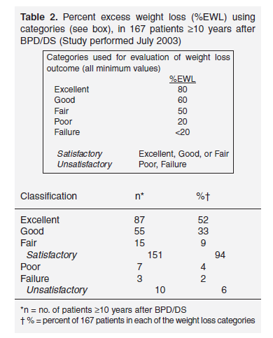
"….Seven of the 37 revisions were for inadequate weight loss. For these patients, only the common channel was shortened. The results were unsatisfactory, as none of the patients lost >9 kg more. However, the revision did appear to prevent further weight gain....."

Slide 39
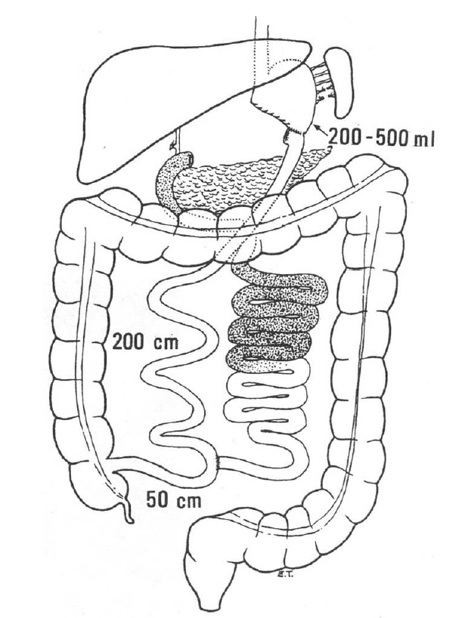
SHORTENING BOTH THE AL AND THE CL

Slide 40
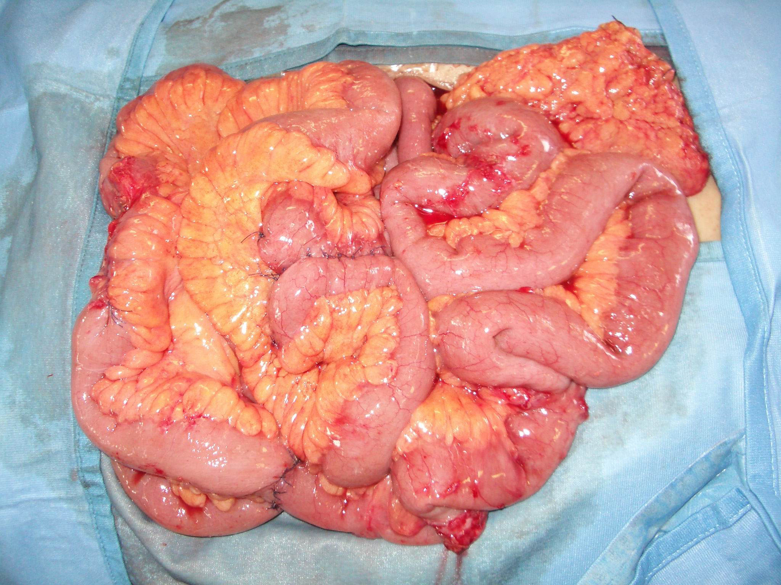

Slide 42
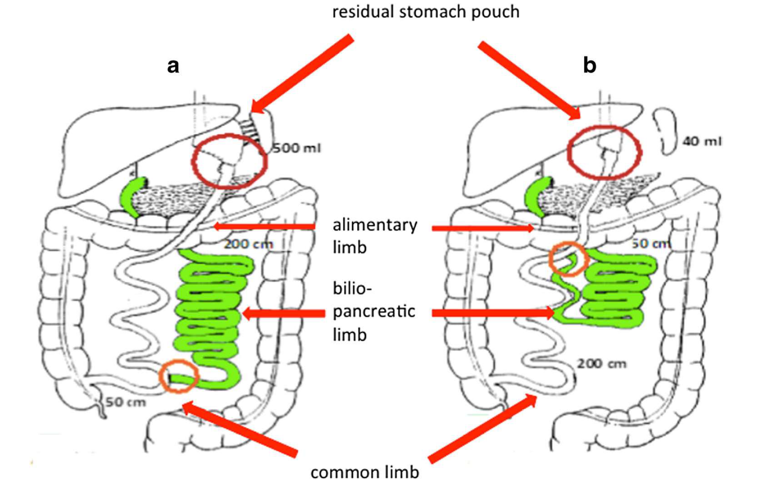

Slide 44

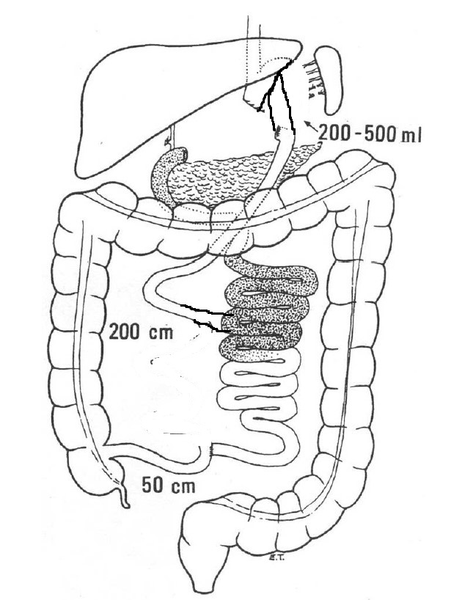
Conversione da BPD in RYGB: Scuola di Genova
BPL 100 cm

Slide 45
Conclusioni
L'insufficiente calo ed il recupero di peso dopo chirurgia bariatrica malassorbitiva è possibile, anche se meno frequente che dopo chirurgia restrittiva (< 10%)
L'incremento del malassorbimento mediante allungamento del tratto biliopancreatico o accorciamento dei tratti alimentare e comune ha una finestra terapeutica stretta e può non portare ai risultati desiderati
Il potenziamento della componente restrittiva è, per contro, più efficace
Necessario follow-up a lungo termine per intercettare le complicanze nutrizionali

Slide 46
Grazie dell’attenzione! francesco.papadia@unige.it

